Slide 1
eLoran – Here to Stay or Gone Away

Slide 2
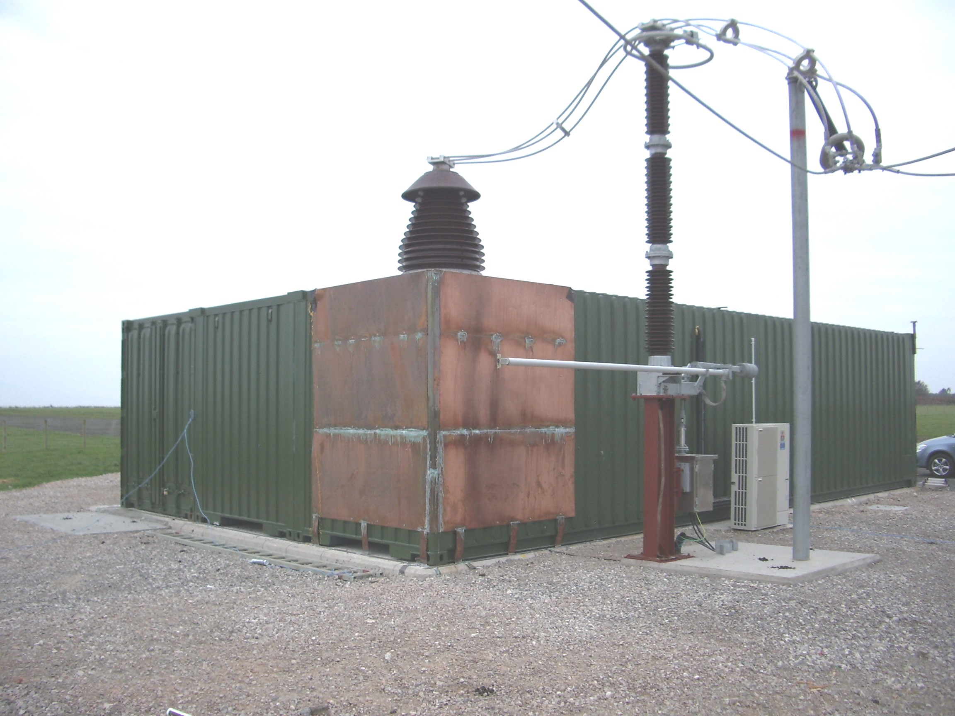
eLoran
Enhanced LOng RAnge Navigation
  High Power Low frequency Time of arrival navigation system
  Minimum 3 transmitters for a “Chain” to enable navigation
  Underpinned by accurate Timing (likewise for GNSS)
Standardised in ITU-R M.589-3 (2001)
eLoran is a TRL9 technology in use in several regions around the world
Currently insufficient infrastructure for navigation around the UK
Provides UTC Time traceability, Navigation and a Data-channel

Slide 3
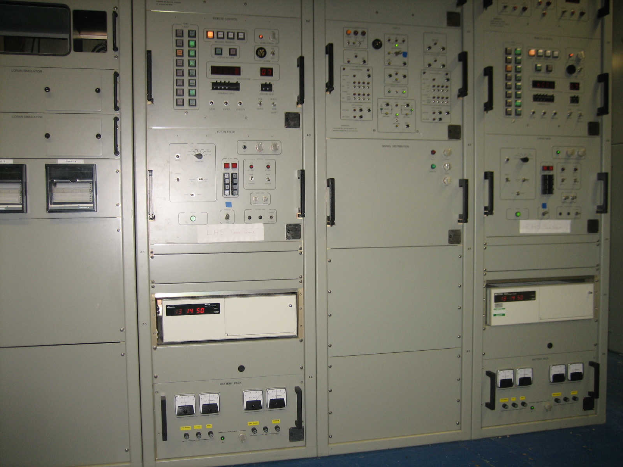
Brief History
LORAN (LOng RAnge Navigation) – 1940’s
  A low frequency Hyperbolic radio navigation system
  Range up to 1500 miles (2400 km)
  Accuracy ~ 10 miles
LoranC
  Introduced chains and greater accuracy
eLoran
  Evolved from LoranC in response to the 2001 Volpe Report on GPS vulnerability
  Introduced a data channel and UTC alignment
Is used in many parts of the world as an alternative/backup to GNSS and is difficult to Jam or spoof providing timing and Navigation assurance.

Slide 4
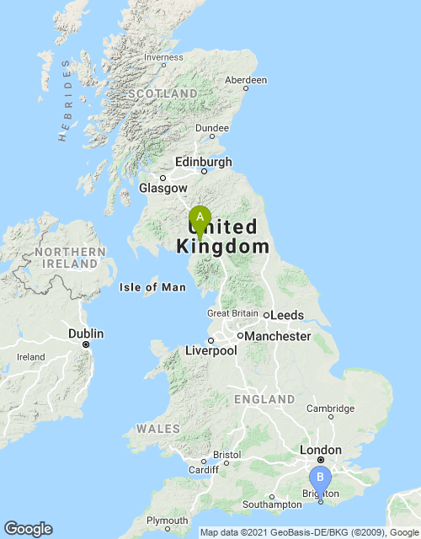
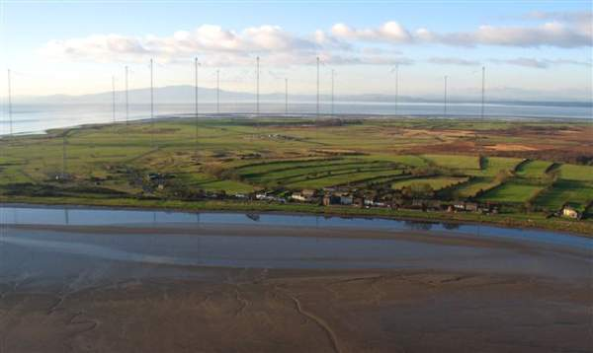
UK (Anthorn in Cumbria)
Anthorn eLoran operates at 100KHz - LF with a pulse power of 400KW
LF signals propagate over the surface and can penetrate ground and buildings
Also refracted off of the ionosphere resulting in an unwanted delayed Sky-Wave

Slide 5
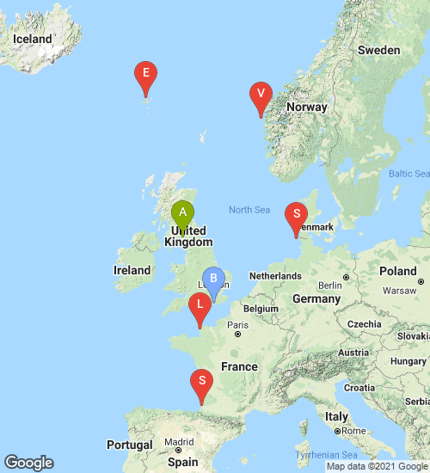
eLoran for UK Navigation
Anthorn currently the only station on GRI 6731 acting as The chain Master and as a secondary (for test purposes)
A – Anthorn Operational 400KWatt
B – Brighton
E – Ejde
L – Lessay (Was chain master also on GRI 7499)
S – Soustons
S – Sylt (GRI 6731 & 7499)
V - Værlandet, Norway
Sadly mostly decommisioned / demolished by our European neighbours

Slide 6
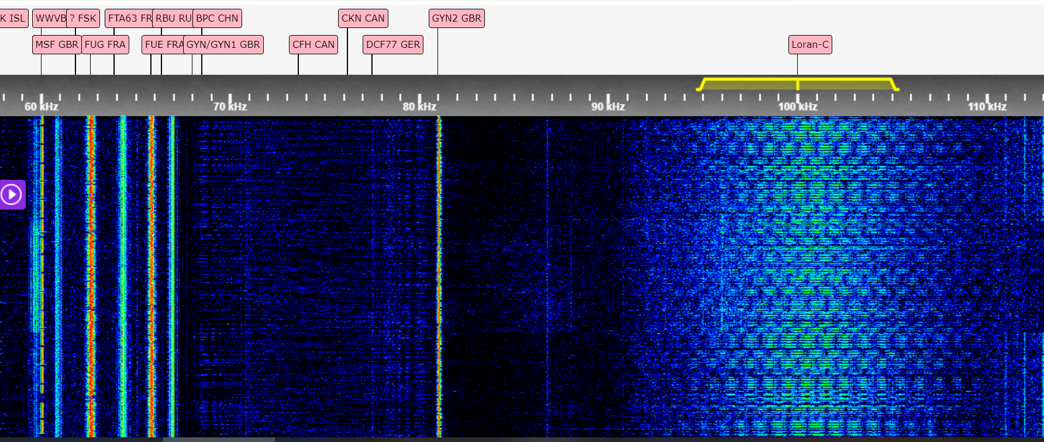
Anthorn Today
Recorded 5th October 2021

Slide 7
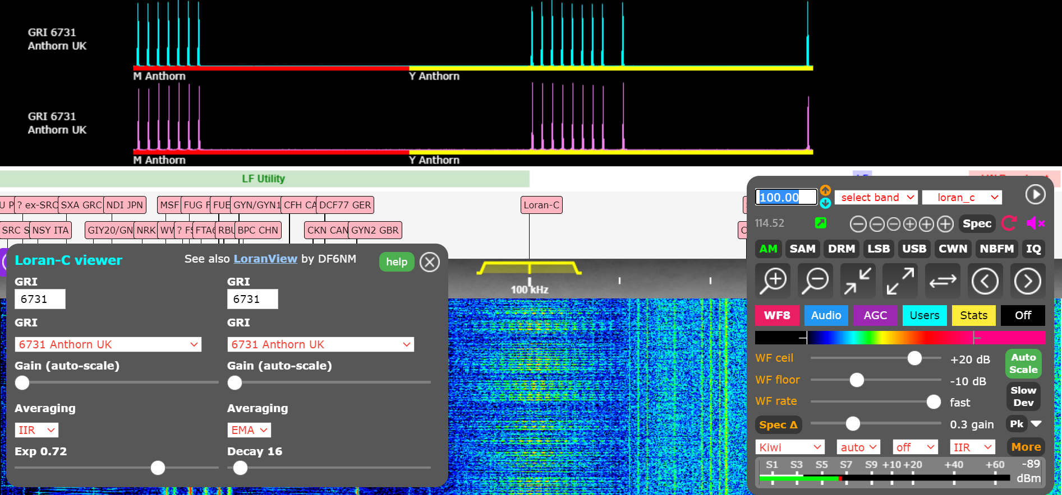
Anthorn Signal
Group Rep Rate
67310us
Emission delay Master to Secondary
10th Pulse (Master)

Slide 8

Propagation
Ground wave
  Follows contours of ground
  Affected by ground impedance and terrain
  Slower over ground than salt-water
Sky wave
  Reflections off of the ionosphere (80-1000km)
  May be similar strength to groundwave
  Adds to groundwave causing amplitude and phase changes
  Skywave is always delayed WRT groundwave

Slide 9
Why LF CW is no good for timing
Classic MW fade in the evening is a good example of this.
LORAN-c and eLoran fix this using pulse transmission rather than CW
This also allow Time division sharing of the spectrum – Much like DAB
Fade but even worse, phase reversal

Slide 10
The LF Pulse
Skywave
60km and greater
T0
A
100kHz carrier
A/2
30us
65us
200us

Slide 11
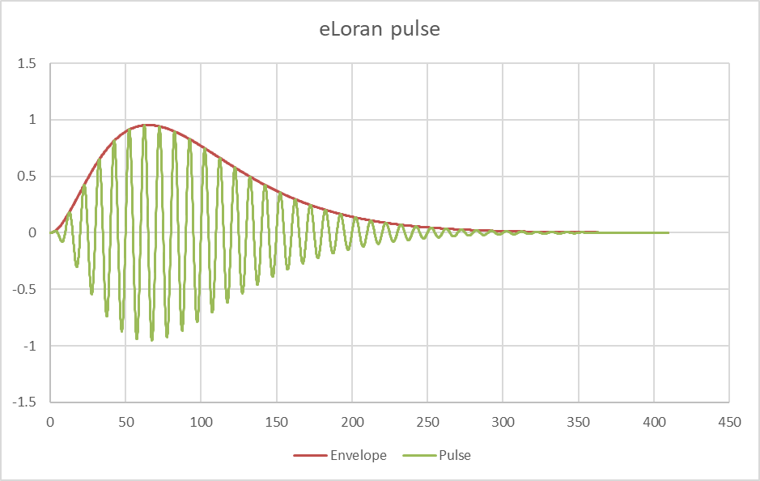
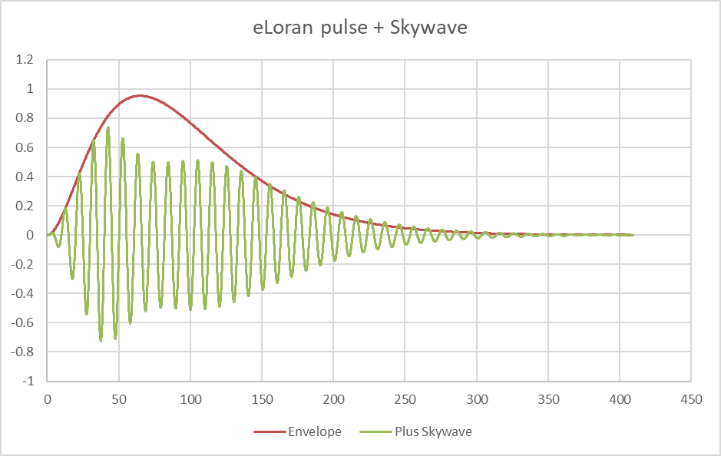
Later cycles will have phase disturbance
Phase reference point
Phase reference point unaffected
Skywave always arrives after the phase reference point

Slide 12
ASF
Additional Secondary Factor
eLoran is effectively “Calibrated” for operation over sea-water
Distance over Land changes with terrain (Hills / Mountains)
Also with soil type and water content

Slide 13
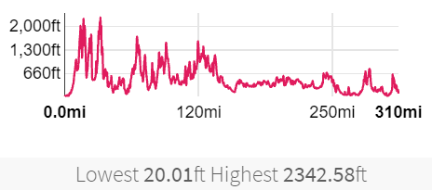
ASF
Additional Secondary Factor
Distance from Anthorn to Brighton is 309 miles (497km) which is 1.657ms at the speed of light
Total ascent and descent from Anthorn to Brighton is around 36,000 feet (11km)
Which could equate to a hill time error of approx. 37 uS without correcting for terrain

Slide 14
North America
Report from USA Department of Transportation – January 2021
  Real word testing of LF (eLoran), UHF and L-Band PNT solutions
eLoran transmitter installed for testing
  NASA Langley Research Centre (Virginia)
    Receiver site
  Joint Base Cape Cod (Massachusetts)
    Receiver site
  United States Coast Guard site at Wildwood (New Jersey – 625” mast pictured)
    Transmitter site

Slide 15
North America
EXPLANATORY STATEMENT FOR THE DEPARTMENTS OF
TRANSPORTATION, AND HOUSING AND URBAN DEVELOPMENT,
AND RELATED AGENCIES APPROPRIATIONS BILL,
2022
Position Navigation and Timing [PNT] Technologies and Global
Positioning System [GPS] Backup.—The Committee supports the
findings in the Department’s January, 2021 ‘‘Complementary PNT
and GPS Backup Technologies Demonstration Report
Position Navigation and Timing [PNT] Technologies and Global
Positioning System [GPS] Backup.—The Committee supports the
findings in the Department’s January, 2021 ‘‘Complementary PNT
and GPS Backup Technologies Demonstration Report (DOT–
VNTSC–20–07)’’, which found that ‘‘the best strategy for achieving
resilient PNT service is to pursue multiple technologies to promote
diversity in the PNT functions that support transportation and
other critical infrastructure sectors.’’ The report found that based
on the demonstration, the technologies that show strong performance,
operational diversity, operational readiness, and cost effectiveness
are the LF and UHF terrestrial and L-band satellite
broadcasts for PNT functions with supporting fiber optic time services
to transmitters/control segments. The Committee recommendation
provides the Secretary $15,000,000 to establish a program that
leads to wide adoption of multiple technologies that provides the
necessary GPS backup and complementary PNT as identified by
the Department’s report. Funding will enable, among other things,
the development of safety-critical PNT requirements and standards,
vulnerability and performance testing, certification protocols
for safety-critical functions, the procurement of services as deemed
appropriate by the Department, and user adoption models in order
to facilitate the responsible use of resilient PNT services to meet
Federal requirements for widespread adoption. The Committee expects
the Department to report its findings and recommendations
enabling GPS backup to the Committee within 1 year of enactment
of this Act.
LF and UHF terrestrial and L-band satellite
broadcasts for PNT functions
The Committee recommendation
provides the Secretary $15,000,000 to establish a program that
leads to wide adoption of multiple technologies that provides the
necessary GPS backup and complementary PNT

Slide 16

ESA NAVISP
UTD (UK Time Distribution)
Three year research project awarded to Chronos under a programme of and funded by the European Space Agency
An Element 3 call
Identify the level of precision that can be provided across the UK by eLoran for various CNI applications independently of GNSS

Slide 17

Deliverables
UK Time Distribution (UTD)
The project outcome will be a clear understanding of the level of precision that can be provided across the UK by eLoran for various CNI applications such as telecoms, power, broadcast, security and defence independently of GNSS
In order to achieve optimised eLoran timing precision, regionally localised eLoran differential timing receivers (EDTR) will be deployed to measure the ground-wave signal delay variation known as the additional secondary factor (ASF)
A secondary technical objective is to evaluate the use of the spare data channels in the LDC for other purposes. These will include (1) Broadcasting GNSS ephemeris data to enhance the ability of GNSS receivers to achieve lock in restricted sky-view or other degraded signal applications, and (2) Broadcasting encrypted data for national security and other purposes.

Slide 18
Capabilities
Accurate UTC
  10ns achievable from UK based receivers from Anthorn + ASF
Data channel
  Distribution of ephemeris data for other systems
Navigation will not be possible from the single Anthorn site

Slide 19

Project Architecture
Internet
VPN
eLoran data
channel. ASF broadcast
Remote
Dashboard
qUTC Caesium tuning
RCU
Caesium 5071a
Loran Timer Unit
PATCO
Control
Console
Common
Transmitter
Blue items
Existing
Caesium 5071a
Loran Timer Unit
PATCO
Salmon items
Repair/Replace
qUTC Caesium tuning
RCU
Green Items
New -

Slide 20
To do
10 sites across the UK will host EDTR receivers
  eLoran Differential Timing Receivers
Additional 5 sites in challenging environments
1 enhanced EDTR site at Chronos
  Greater precision measurements
Enhanced data channel (Approx. 8Kbit/s)
Develop a deployment profile for a nationwide EDTR network, eg: 50/100 sites across the UK

Slide 21
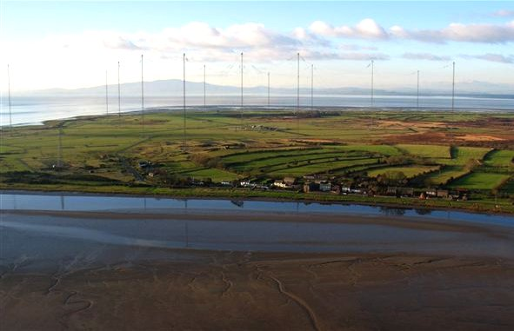
Continuity of eLoran transmission at Anthorn
ESA NAVISP Element 3
AO/1-9427/18/NL/MP
Chronos has secured the operation of the Anthorn Transmitter for the duration of the project and for and undisclosed period afterwards.
This gives us the certainty of being able to characterise the timing performance that can be achieved by generating detailed ASF maps and algorithms

Slide 22
Looking ahead
Short timescales for Synchronisation capabilities to the UK
Medium term – With extra transmitter sites - UK Navigation
Longer term – More systems coming alive internationally

Slide 23
Presented by Tony Flavin
Contact details tony.flavin@chronos.co.uk
eLoran – Here to stay or Gone Away?

